Slide 1
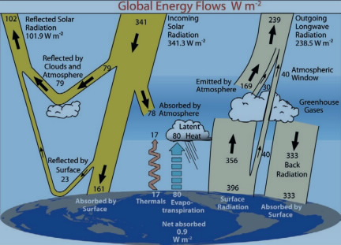
Blackbody emission

Slide 2
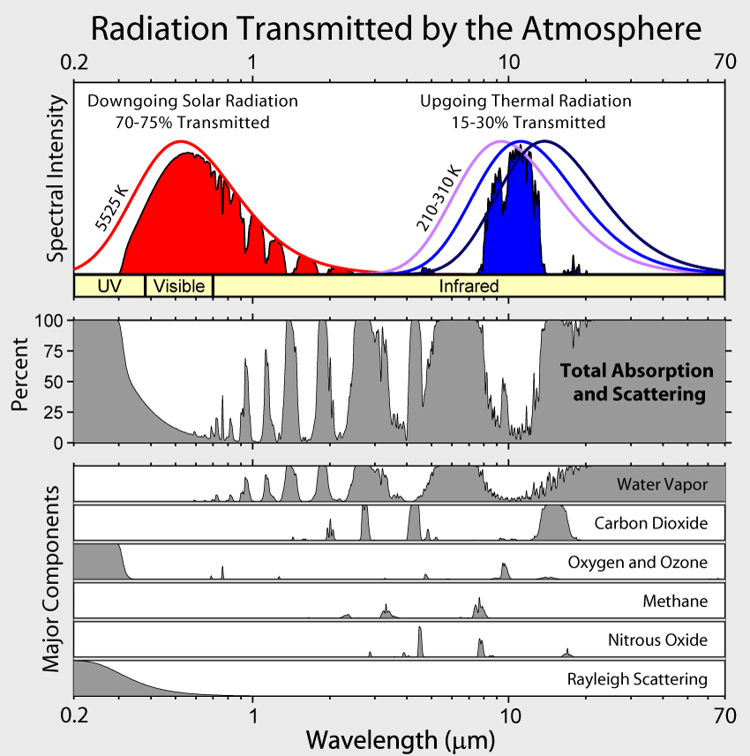
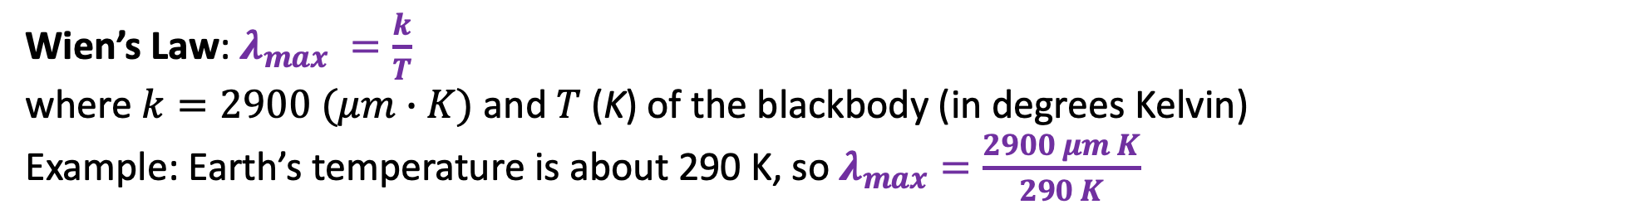
Reminder: Blackbody Spectra and Wien’s Law
Wien’s Law: $λ_{max} =\frac{k}{T}$
where $k=2900 (μm∙K)$ and $T$(K) of the blackbody (in degrees Kelvin)
Example: Earth’s temperature is about 290 K, so $λ_{max}=\frac{2900 μm K}{290 K}$

Slide 3
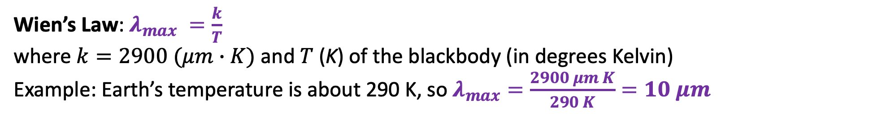
Reminder: Blackbody Spectra and Wien’s Law
Wien’s Law: $λ_{max} =\frac{k}{T}$
where $k=2900 (μm∙K)$ and $T$(K) of the blackbody (in degrees Kelvin)
Example: Earth’s temperature is about 290 K, so $λ_{max}=\frac{2900 μm K}{290 K}=10 μm$

Slide 4
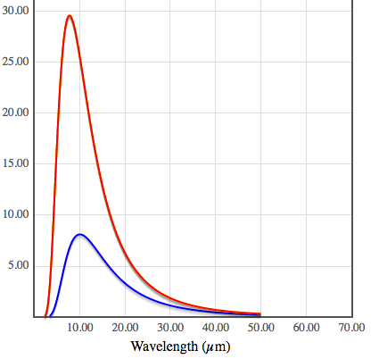
Reminder: Blackbody Spectra and Wien’s Law
https://phet.colorado.edu/sims/html/blackbody-spectrum/latest/blackbody-spectrum_en.html
Here you can see that the peak of the red curve has shifted a little toward lower wavelengths.
How hot is that body?

Slide 5
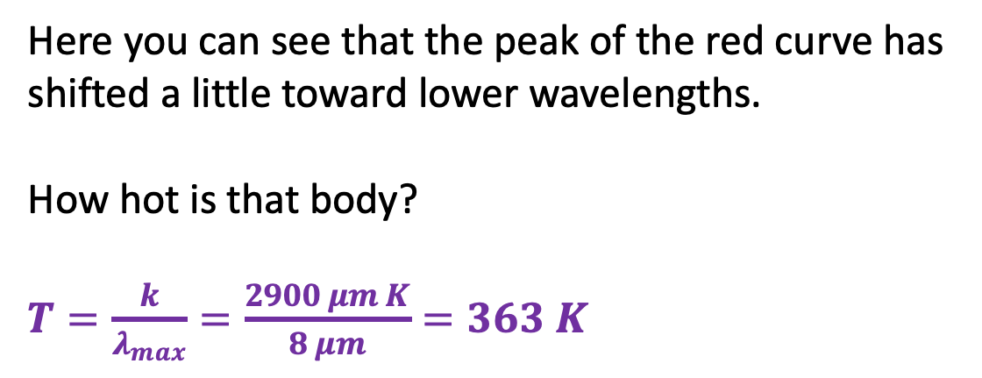
Reminder: Blackbody Spectra and Wien’s Law
https://phet.colorado.edu/sims/html/blackbody-spectrum/latest/blackbody-spectrum_en.html
Here you can see that the peak of the red curve has shifted a little toward lower wavelengths.
How hot is that body?
$T=\frac{k}{λ_{max}}=\frac{2900 μm K}{8 μm}=363 K$

Slide 6
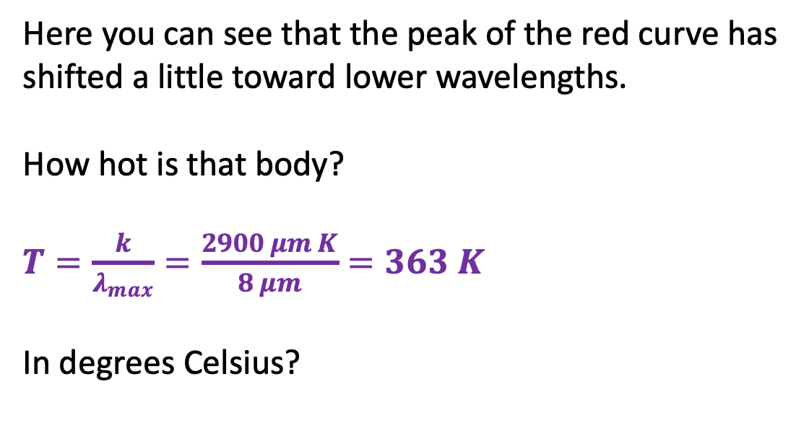
Reminder: Blackbody Spectra and Wien’s Law
https://phet.colorado.edu/sims/html/blackbody-spectrum/latest/blackbody-spectrum_en.html
Here you can see that the peak of the red curve has shifted a little toward lower wavelengths.
How hot is that body?
$T=\frac{k}{λ_{max}}=\frac{2900 μm K}{8 μm}=363 K$
In degrees Celsius?

Slide 7
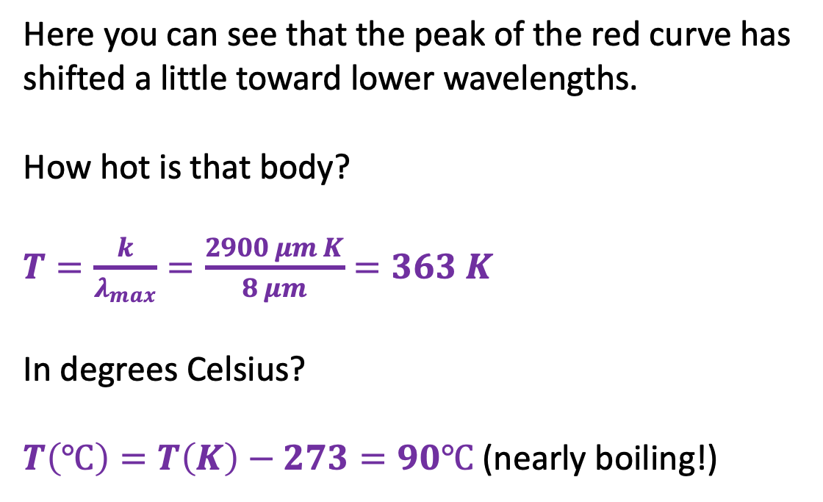
Reminder: Blackbody Spectra and Wien’s Law
https://phet.colorado.edu/sims/html/blackbody-spectrum/latest/blackbody-spectrum_en.html
Here you can see that the peak of the red curve has shifted a little toward lower wavelengths.
How hot is that body?
$T=\frac{k}{λ_{max}}=\frac{2900 μm K}{8 μm}=363 K$
In degrees Celsius?
$T\left(℃\right)=T\left(K\right)−273=90℃$ (nearly boiling!)

Slide 8
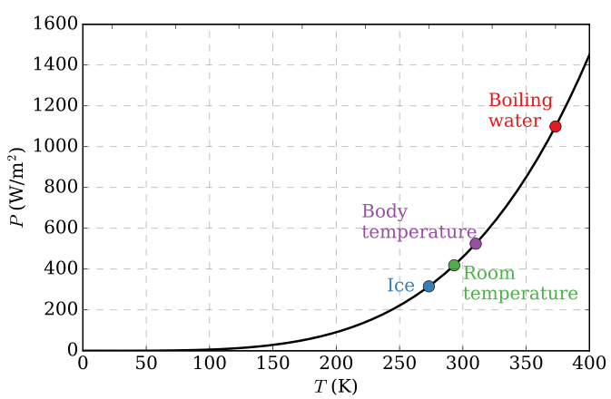
Stefan-Boltzmann
Stefan-Boltzmann power
The Stefan-Boltzmann power is the total energy emitted by each square meter of an object (like the surface of the Earth, or your skin), summed over all the wavelengths.

Slide 9
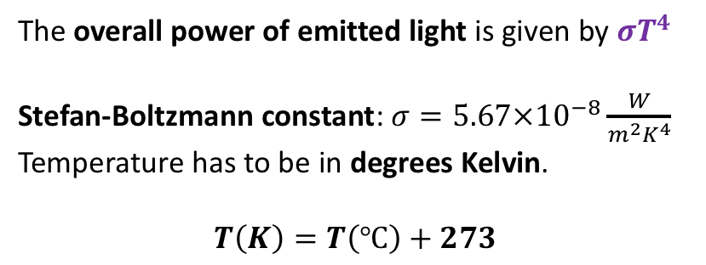
Stefan-Boltzmann
Stefan-Boltzmann power
The overall power of emitted light is given by $σT^{4}$
Stefan-Boltzmann constant: $σ=5.67×10^{−8}\frac{W}{m^{2}K^{4}}$
Temperature has to be in degrees Kelvin.
$$T\left(K\right)=T\left(℃\right)+273$$

Slide 10
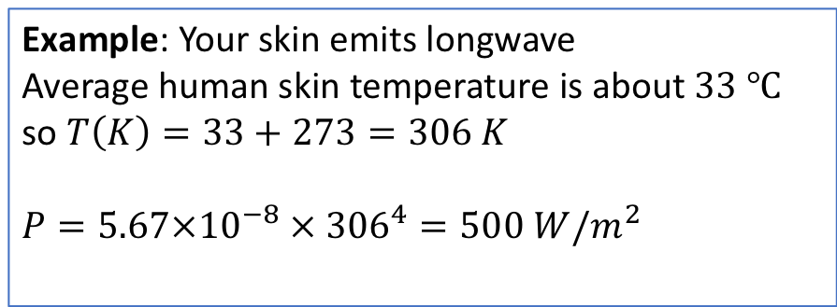
Stefan-Boltzmann
Stefan-Boltzmann power
The overall power of emitted light is given by $σT^{4}$
Stefan-Boltzmann constant: $σ=5.67×10^{−8}\frac{W}{m^{2}K^{4}}$
Temperature has to be in degrees Kelvin.
$$T\left(K\right)=T\left(℃\right)+273$$
Example: Your skin emits longwave
Average human skin temperature is about $33 ℃$ so $T\left(K\right)=33+273=306 K$
$$P=5.67×10^{−8} × {306}^{4}=500 W/m^{2}$$

Slide 11
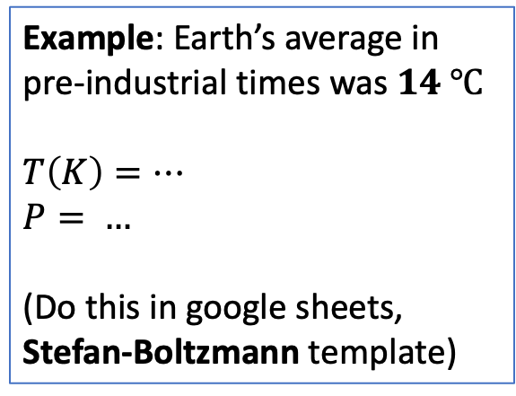
Stefan-Boltzmann
Stefan-Boltzmann power
The overall power of emitted light is given by $σT^{4}$
Stefan-Boltzmann constant: $σ=5.67×10^{−8}\frac{W}{m^{2}K^{4}}$
Temperature has to be in degrees Kelvin.
$$T\left(K\right)=T\left(℃\right)+273$$
Example: Earth’s average in pre-industrial times was $14 ℃$
$T\left(K\right)=…$
$$P= …$$
(Do this in google sheets, Stefan-Boltzmann template)
Earth at 14 degrees C

Slide 12

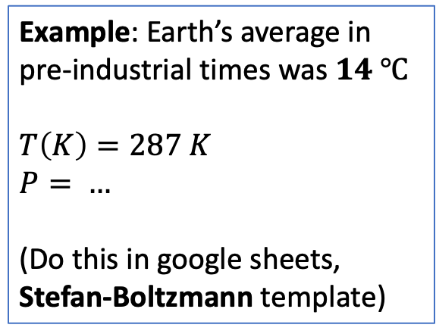

Stefan-Boltzmann
Stefan-Boltzmann power
The overall power of emitted light is given by $σT^{4}$
Stefan-Boltzmann constant: $σ=5.67×10^{−8}\frac{W}{m^{2}K^{4}}$
Temperature has to be in degrees Kelvin.
$$T\left(K\right)=T\left(℃\right)+273$$
Example: Earth’s average in pre-industrial times was $14 ℃$
$T\left(K\right)=287 K$
$$P= …$$
(Do this in google sheets, Stefan-Boltzmann template)
Earth at 14 degrees C
320

Slide 13
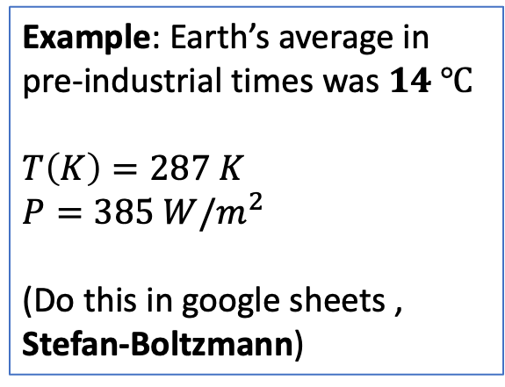
Stefan-Boltzmann
Stefan-Boltzmann power
The overall power of emitted light is given by $σT^{4}$
Stefan-Boltzmann constant: $σ=5.67×10^{−8}\frac{W}{m^{2}K^{4}}$
Temperature has to be in degrees Kelvin.
$$T\left(K\right)=T\left(℃\right)+273$$
Example: Earth’s average in pre-industrial times was $14 ℃$
$T\left(K\right)=287 K$
$$P=385 W/m^{2}$$
(Do this in google sheets , Stefan-Boltzmann)
Earth at 14 degrees C
385

Slide 14
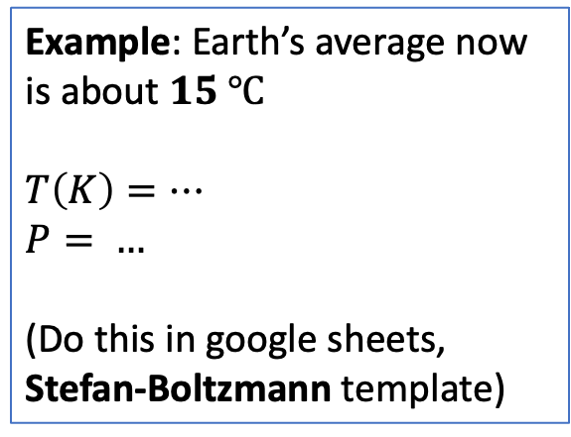
Stefan-Boltzmann
Stefan-Boltzmann power
The overall power of emitted light is given by $σT^{4}$
Stefan-Boltzmann constant: $σ=5.67×10^{−8}\frac{W}{m^{2}K^{4}}$
Temperature has to be in degrees Kelvin.
$$T\left(K\right)=T\left(℃\right)+273$$
Example: Earth’s average now is about $15 ℃$
$T\left(K\right)=…$
$$P= …$$
(Do this in google sheets, Stefan-Boltzmann template)
Earth at 15 degrees C

Slide 15
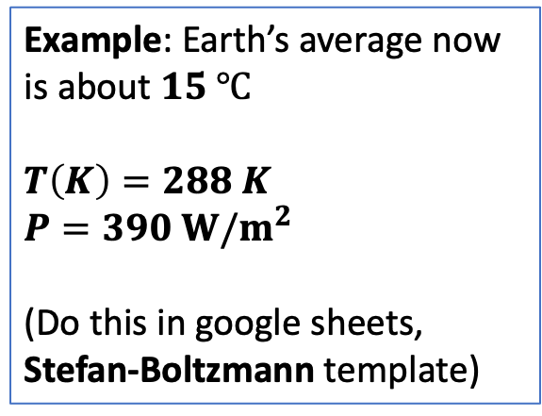
Stefan-Boltzmann
Stefan-Boltzmann power
The overall power of emitted light is given by $σT^{4}$
Stefan-Boltzmann constant: $σ=5.67×10^{−8}\frac{W}{m^{2}K^{4}}$
Temperature has to be in degrees Kelvin.
$$T\left(K\right)=T\left(℃\right)+273$$
Example: Earth’s average now is about $15 ℃$
$T\left(K\right)=288 K$
$$P=390 W/m^{2}$$
(Do this in google sheets, Stefan-Boltzmann template)
Earth at 15 degrees C
390

Slide 16
Lab handout below here

Slide 17
The Simple Radiative Balance model
320
Use Stefan-Boltzmann formula

Slide 18
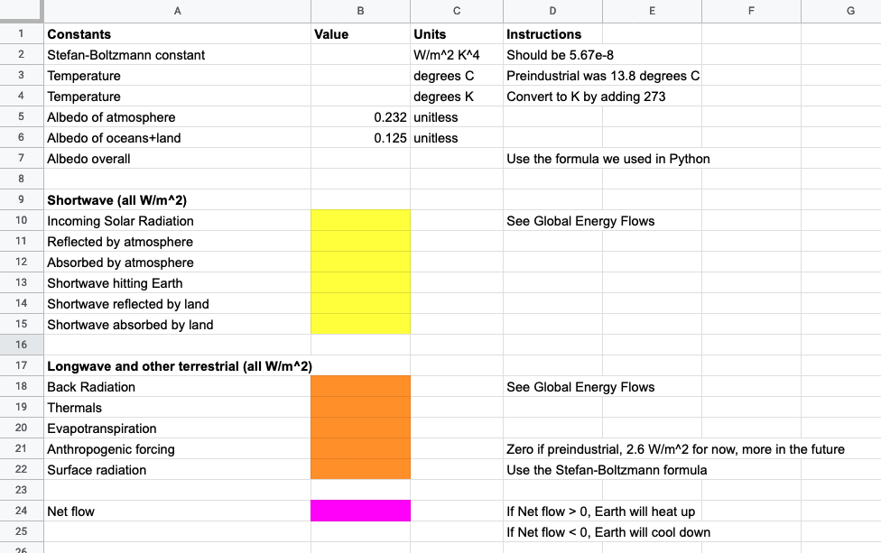
The Simple Radiative Balance model

